Slide 1
INTRODUCTION TO DATABASE MANAGEMENT SYSTEM (IDMS)
Lecture 2
Barnali Goswami

Slide 2
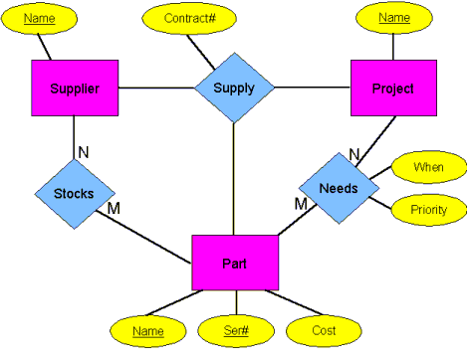
Entity Relationship Model (ER)

Slide 3
Entity Relationship Model (ER)
Defines conceptual view of database.
Finds out the real world entities and the associations among them.
It is based on top down approach.
Advantages:
Easy to learn.
Easy to change to other data models.
Easy to view the entire system.
Disadvantages:
No industry standard for notation.
Appropriate for high level design.

Slide 4
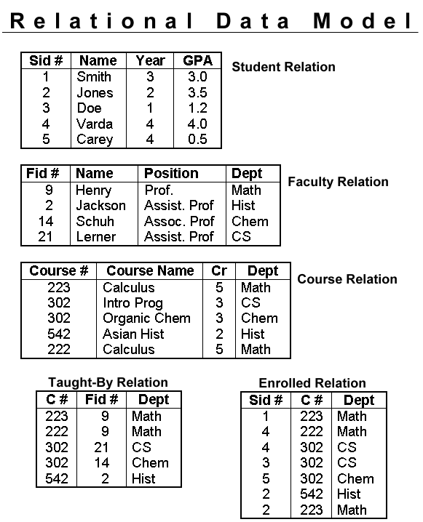
Relational Model

Slide 5
Relational Data Model
Developed by Codd.
Data and their relations are organised in tables.
Most popular.
Advantages:
Simple
Easy query handling (using DML)
Easy to append relations
Security
Data Independence
Disadvantages:
Performance
Physical storage consumption

Slide 6
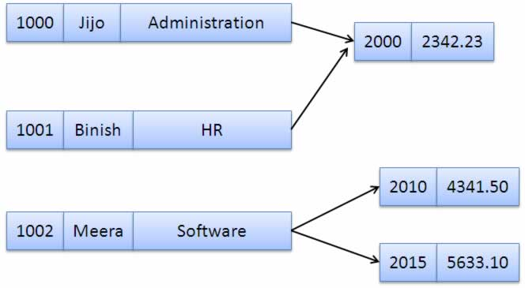
Network Data Model

Slide 7
Network Data Model
Similar to ER diagram.
Collection of records connected to one another through links.
Each record a collection of fields (attributes), each of which contains only one data value.
Link is restricted to binary form of relationship.

Slide 8
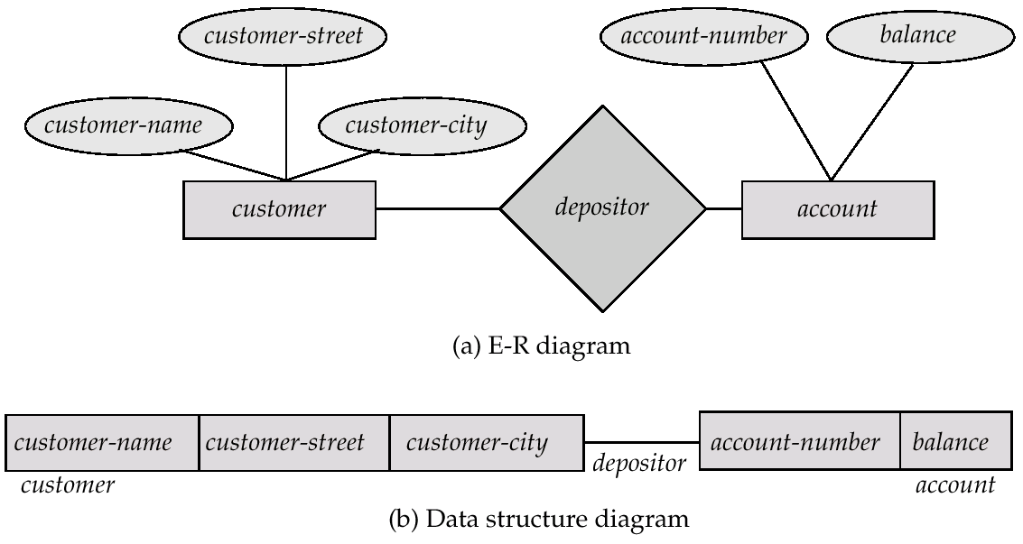
ER Diagram Vs Network Diagram

Slide 9
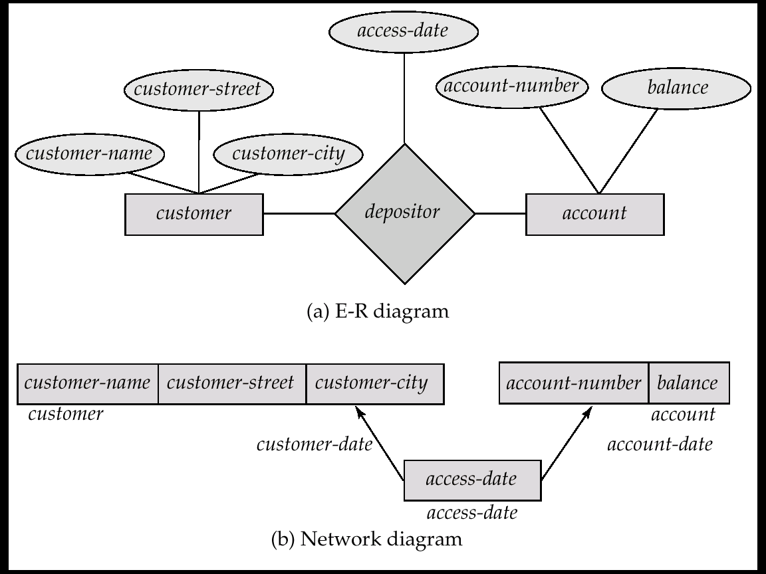
ER Diagram Vs Network Diagram

Slide 10
Network Data Model
Advantages:
Simplicity
Ability to handle more relationship types
Ease of data access
Disadvantages:
System complexity
Lack of structural independence

Slide 11
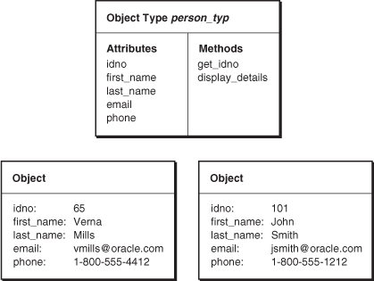
Object-Oriented Data Model

Slide 12
Object-Oriented Data Model
Combines the concept of object-oriented in database.
Objects, classes, attributes, methods are used in data modeling.

Slide 13
Object Oriented Data Model
Advantages:
Enriched modeling capabilities
Extensibility
Removal of impedance mismatch between DML and programming languages
Improved performance
Disadvantages:
Lack of universal data model and standards
Complexity
Lack of support for views

Slide 14
Hierarchical Data Model
Organizes database with multiple one to many relationships.
One parent can have several children but children are allowed only one parent.
Looks like a tree with a single root.
Created by IBM and implemented in IMS.

Slide 15
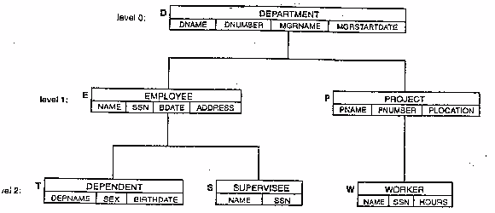
Hierarchical Data Model

Slide 16
Hierarchical Data Model
Advantages:
Data integrity
Efficiency
Data security
Disadvantages:
Implementation complexity
Lack of structural independence
Operational anomalies

Slide 17
To do
Find out some application areas for the different Data Models of DBMS.

Slide 18
Next
Entity Relationship Model.

